Slide 1
Management
Eleventh Edition
Chapter 5
Managing Social Responsibility and Ethics
Copyright © 2018, 2016, 2014 Pearson Education, Inc. All Rights Reserved

Slide 2
Learning Objectives
5.1 Discuss what it means to be socially responsible and what factors influence that decision.
5.2 Explain green management and how organizations can go green.
5.3 Discuss the factors that lead to ethical and unethical behavior.
Develop your skill at creating trust in work groups.
5.4 Describe management’s role in encouraging ethical behavior.
Know how to make good decisions about ethical dilemmas.
5.5 Discuss current social responsibility and ethics issues.

Slide 3
From Obligations to Responsiveness to Responsibility
Social obligation: when a firm engages in social actions because of its obligation to meet certain economic and legal responsibilities
Classical view: the view that management’s only social responsibility is to maximize profits
Notes:
The concept of social responsibility has been described in different ways. For instance, it’s been called “profit making only,” “going beyond profit making,” “any discretionary corporate activity intended to further social welfare,” and “improving social or environmental conditions.” We can understand it better if we first compare it to two similar concepts: social obligation and social responsiveness. Social obligation is when a firm engages in social actions because of its obligation to meet certain economic and legal responsibilities. The organization does what it’s obligated to do and nothing more. This idea reflects the classical view of social responsibility, which says that management’s only social responsibility is to maximize profits. The most outspoken advocate of this approach is economist and Nobel laureate Milton Friedman. He argued that managers’ primary responsibility is to operate the business in the best interests of the stockholders, whose primary concerns are financial.

Slide 4
The Socioeconomic View
Socioeconomic view: the view that managers’ social responsibilities go beyond making profits to include protecting and improving society’s welfare
Social responsiveness: when a company engages in social actions in response to some popular social need
Social responsibility: A business’s intention, beyond its legal and economic obligations, to do the right things and act in ways that are good for society
Notes:
The other two concepts—social responsiveness and social responsibility—reflect the socioeconomic view, which says that managers’ social responsibilities go beyond making profits to include protecting and improving society’s welfare. This view is based on the belief that corporations are not independent entities responsible only to stockholders, but have an obligation to the larger society. Organizations around the world have embraced this view as shown by a survey of global executives in which 84 percent said that companies must balance obligations to shareholders with obligations to the public good.
Social responsiveness is when a company engages in social actions in response to some popular social need. Managers are guided by social norms and values and make practical, market-oriented decisions about their actions. For instance, Ford Motor Company became the first automaker to endorse a federal ban on sending text messages while driving.
A socially responsible organization goes beyond what it’s obligated to do or chooses to do because of some popular social need and does what it can to help improve society because it’s the right thing to do. We define social responsibility as a business’s intention, beyond its legal and economic obligations, to do the right things and act in ways that are good for society. A socially responsible organization does what is right because it feels it has an ethical responsibility to do so.

Slide 5
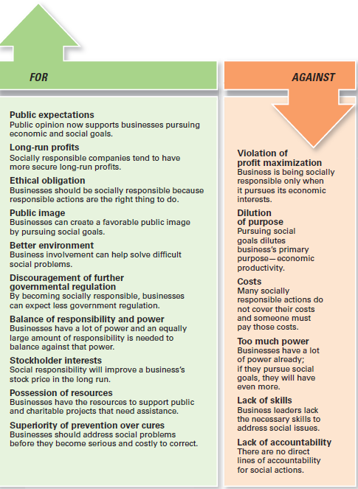
Exhibit 5-1 Arguments For and Against Social Responsibility
Exhibit 5-1 outlines arguments for and against social involvement.
Notes:
Other than meeting their social obligations (which they must do), should organizations be socially involved? One way to look at this question is by examining arguments for and against social involvement. Several points are outlined in Exhibit 5-1.

Slide 6
Green Management and Sustainability
Green management: managers consider the impact of their organization on the natural environment
Notes:
Until the late 1960s, few people (and organizations) paid attention to the environmental consequences of their decisions and actions. However, a number of environmental disasters brought a new spirit of environmentalism to individuals, groups, and organizations. Increasingly, managers have begun to consider the impact of their organization on the natural environment, which we call green management.

Slide 7
How Organizations Go Green
Legal (light green) approach (Social Obligations)
Market approach (respond to environmental preferences of customers)
Stakeholder approach (to meet the environmental demands of multiple stakeholders)
Activist approach (it looks for ways to protect the earth’s natural resources)
Notes:
Managers and organizations can do many things to protect and preserve the natural environment. Some do no more than what is required by law; that is, they fulfill their social obligation. The first approach, the legal (or light green) approach, is simply doing what is required legally. In this approach, which illustrates social obligation, organizations exhibit little environmental sensitivity. They obey laws, rules, and regulations without legal challenge and that’s the extent of their being green.
As an organization becomes more sensitive to environmental issues, it may adopt the market approach and respond to environmental preferences of customers. Whatever customers demand in terms of environmentally friendly products will be what the organization provides.
In the stakeholder approach, an organization works to meet the environmental demands of multiple stakeholders such as employees, suppliers, or community.
Finally, if an organization pursues an activist (or dark green) approach, it looks for ways to protect the earth’s natural resources. The activist approach reflects the highest degree of environmental sensitivity and illustrates social responsibility.

Slide 8
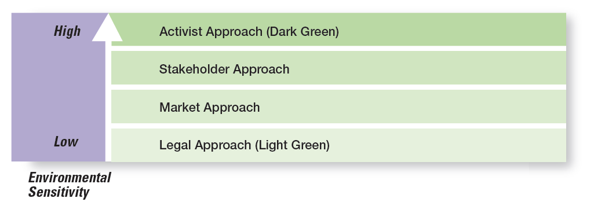
Exhibit 5-2 Green Approaches
Exhibit 5-2 uses the terms shades of green to describe the different environmental approaches that organizations may take.
Notes:
Source: Based on R. E. Freeman, J. Pierce, and R. Dodd, Shades of Green: Business Ethics and the Environment (New York: Oxford University Press, 1995).

Slide 9
Managers and Ethical Behavior
Ethics: principles, values, and beliefs that define right and wrong behavior
Notes:
What do we mean by ethics? We’re defining it as the principles, values, and beliefs that define right and wrong decisions and behavior. Many decisions managers make require them to consider both the process and who’s affected by the result. To better understand the ethical issues involved in such decisions, let’s look at the factors that determine whether a person acts ethically or unethically.

Slide 10
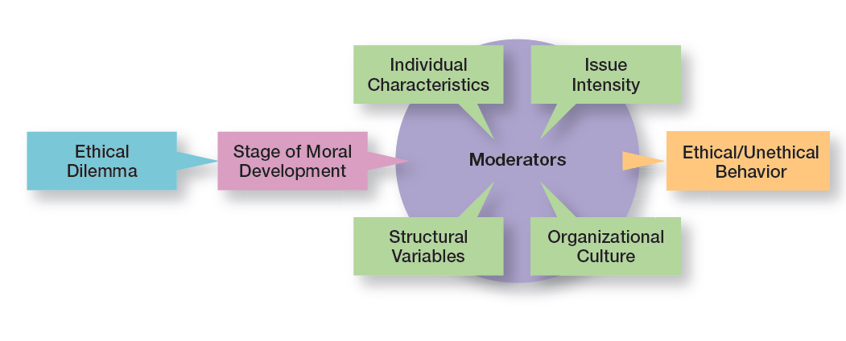
Exhibit 5-3 Factors that Determine Ethical and Unethical Behavior
Exhibit 5-3 shows factors that determine ethical and unethical behavior.
Notes:
Whether someone behaves ethically or unethically when faced with an ethical dilemma is influenced by several things: his or her stage of moral development and other moderating variables, including individual characteristics and the organization’s structural design, which we will discuss in a later section of the chapter, and the intensity of the ethical issue.

Slide 11
Individual Characteristics
Two individual characteristics—values and personality— play a role in determining whether a person behaves ethically.
Values (basic convictions about what is right and wrong) (personal life and experience).
Personality
Ego strength (measures the strength of a person’s convictions)
Locus of control (is the degree to which people believe they control their own fate) (internal control their own destiny, external consider it a luck).
Notes:
Two individual characteristics—values and personality—play a role in determining whether a person behaves ethically. Each person comes to an organization with a relatively entrenched set of personal values, which represent basic convictions about what is right and wrong. Our values develop from a young age based on what we see and hear from parents, teachers, friends, and others.
Two personality variables have been found to influence an individual’s actions according to his or her beliefs about what is right or wrong: ego strength and locus of control. Ego strength measures the strength of a person’s convictions. People with high ego strength are likely to resist impulses to act unethically and instead follow their convictions. Locus of control is the degree to which people believe they control their own fate. People with an internal locus of control believe they control their own destinies. They’re more likely to take responsibility for consequences and rely on their own internal standards of right and wrong to guide their behavior.

Slide 12
Structural Variables
Ethical behavior can be influenced by:
An organization’s structural design
Goals
Performance appraisal system
Reward allocation
Notes:
Those structures that minimize ambiguity and uncertainty with formal rules and regulations and those that continuously remind employees of what is ethical are more likely to encourage ethical behavior.
Although many organizations use goals to guide and motivate employees, those goals can create some unexpected problems. One study found that people who don’t reach set goals are more likely to engage in unethical behavior, even if they do or don’t have economic incentives to do so
An organization’s performance appraisal system can also influence ethical behavior. Some systems focus exclusively on outcomes, while others evaluate means as well as ends. When employees are evaluated only on outcomes, they may be pressured to do whatever is necessary to look good on the outcomes and not be concerned with how they got those results.
The more that rewards or punishment depend on specific goal outcomes, the more employees are pressured to do whatever they must to reach those goals—perhaps to the point of compromising their ethical standards.

Slide 13
Exhibit 5-5 Issue Intensity
As Exhibit 5-5 shows, six characteristics determine issue intensity or how important an ethical issue is to an individual: greatness of harm, consensus of wrong, probability of harm, immediacy of consequences, proximity to victim(s), and concentration of effect.
Notes:
As Exhibit 5-5 shows, six characteristics determine issue intensity or how important an ethical issue is to an individual: greatness of harm, consensus of wrong, probability of harm, immediacy of consequences, proximity to victim(s), and concentration of effect.

Slide 14
Issue Intensity
The six factors suggest that:
the larger the number of people harmed
the more agreement that the action is wrong
the greater the likelihood that the action will cause harm
the more immediately the consequences of the action will be felt
the closer the person feels to the victim
The more concentrated the effect of the action on the victim(s)…
The greater the issue intensity or importance
Notes:
A student who would never consider breaking into an instructor’s office to steal an accounting exam doesn’t think twice about asking a friend who took the same course from the same instructor last semester what questions were on an exam. Similarly, a manager might think nothing about taking home a few office supplies, yet be highly concerned about the possible embezzlement of company funds. These examples illustrate the final factor that influences ethical behavior: the intensity of the ethical issue itself.

Slide 15
Codes of Ethics and Decision Rules
Code of ethics: a formal statement of an organization’s primary values and the ethical rules it expects its employees to follow
Notes:
Uncertainty about what is and is not ethical can be a problem for employees. A code of ethics, a formal statement of an organization’s values and the ethical rules it expects employees to follow, is a popular choice for reducing that ambiguity. Research shows that 97 percent of organizations with more than 10,000 employees have a written code of ethics.

Slide 16
Exhibit 5-7 Codes of Ethics (1 of 3)
Cluster 1. Be a Dependable Organizational Citizen
1. Comply with safety, health, and security regulations.
2. Demonstrate courtesy, respect, honesty, and fairness.
3. Illegal drugs and alcohol at work are prohibited.
4. Manage personal finances well.
5. Exhibit good attendance and punctuality.
6. Follow directives of supervisors.
7. Do not use abusive language.
8. Dress in business attire.
9. Firearms at work are prohibited.
Exhibit 6-7 shows the three categories into which the content of codes of ethics falls.
Notes:
Source: F. R. David, “An Empirical Study of Codes of Business Ethics: A Strategic Perspective,” paper presented at the 48th Annual Academy of Management Conference, August 1988, Anaheim, California. Used with permission of Fred David.

Slide 17
Exhibit 5-7 Codes of Ethics (2 of 3)
Cluster 2. Do Not Do Anything Unlawful or Improper That Will Harm the Organization
1. Conduct business in compliance with all laws.
2. Payments for unlawful purposes are prohibited.
3. Bribes are prohibited.
4. Avoid outside activities that impair duties.
5. Maintain confidentiality of records.
6. Comply with all antitrust and trade regulations.
7. Comply with all accounting rules and controls.
8. Do not use company property for personal benefit.
9. Employees are personally accountable for company funds.
10. Do not propagate false or misleading information.
11. Make decisions without regard for personal gain.
Exhibit 6-7 shows the three categories into which the content of codes of ethics falls.
Notes:
Source: F. R. David, “An Empirical Study of Codes of Business Ethics: A Strategic Perspective,” paper presented at the 48th Annual Academy of Management Conference, August 1988, Anaheim, California. Used with permission of Fred David.

Slide 18
Exhibit 5-7 Codes of Ethics (3 of 3)
Cluster 3. Be Good to Customers
1. Convey true claims in product advertisements.
2. Perform assigned duties to the best of your ability.
3. Provide products and services of the highest quality.
Exhibit 5-7 shows the three categories into which the content of codes of ethics falls.
Notes:
Source: F. R. David, “An Empirical Study of Codes of Business Ethics: A Strategic Perspective,” paper presented at the 48th Annual Academy of Management Conference, August 1988, Anaheim, California. Used with permission of Fred David.

Slide 19
Developing Codes of Ethics
Organizational leaders should model appropriate behavior and reward those who act ethically.
Managers should reaffirm the importance of the ethics code and discipline those who break it
Stakeholders should be considered as an ethics code is developed or improved
Managers should communicate and reinforce the ethics code regularly
Managers should use the five-step process to guide employees when faced with ethical dilemmas
Notes:
Unfortunately, codes of ethics may not work as well as we think they should. A survey of employees in U.S. businesses found that 41 percent of those surveyed had observed ethical or legal violations in the previous 12 months, including such things as conflicts of interest, abusive or intimidating behavior, and lying to employees. And 37 percent of those employees didn’t report observed misconduct. Does this mean that codes of ethics shouldn’t be developed? No. However, in doing so, managers should use these suggestions.

Slide 20
Exhibit 5-8 A Process for Addressing Ethical Dilemmas
A Process for Addressing Ethical Dilemmas
Step 1: What is the ethical dilemma?
Step 2: Who are the affected stakeholders?
Step 3: Which personal, organizational, and external factors are important in this decision?
Step 4: What are possible alternatives?
Step 5: What is my decision and how will I act on it?
Exhibit 5-8 shows the five-step process to guide employees when faced with ethical dilemmas.
Notes:
Managers should use the five-step process to guide employees when faced with ethical dilemmas.

Slide 21
Leadership at the Top
Doing business ethically requires a commitment from managers at all levels, but especially the top level because:
they uphold the shared values and set the cultural tone
they’re role models in both words and actions
Notes:
Doing business ethically requires a commitment from managers at all levels, but especially the top level. Why? Because they’re the ones who uphold the shared values and set the cultural tone. They’re role models in terms of both words and actions, though what they do is far more important than what they say. If top managers, for example, take company resources for their personal use, inflate their expense accounts, or give favored treatment to friends, they imply that such behavior is acceptable for all employees.

Slide 22
Job Goals and Performance Appraisal
Under the stress of unrealistic goals, otherwise ethical employees may feel they have no choice but to do whatever is necessary to meet those goals.
Notes:
Under the stress of unrealistic goals, otherwise ethical employees may feel they have no choice but to do whatever is necessary to meet those goals. Also, goal achievement is usually a key issue in performance appraisal. If performance appraisals focus only on economic goals, ends will begin to justify means. To encourage ethical behavior, both ends and means should be evaluated. For example, a manager’s annual review of employees might include a point-by-point evaluation of how their decisions measured up against the company’s code of ethics as well as how well goals were met.

Slide 23
Ethics Training
More organizations are setting up seminars, workshops, and similar ethics training programs to encourage ethical behavior.
Notes:
Such training programs aren’t without controversy, as the primary concern is whether ethics can be taught. Critics stress that the effort is pointless because people establish their individual value systems when they’re young. Proponents note, however, that several studies have shown that values can be learned after early childhood. In addition, they cite evidence that shows that teaching ethical problem solving can make an actual difference in ethical behaviors; that training has increased individuals’ level of moral development; and that, if nothing else, ethics training increases awareness of ethical issues in business.

Slide 24
Independent Social Audits
Independent social audits: evaluate decisions and management practices in terms of the organization’s code of ethics
Notes:
The fear of being caught can be an important deterrent to unethical behavior. Independent social audits, which evaluate decisions and management practices in terms of the organization’s code of ethics, increase that likelihood. Such audits can be regular evaluations or they can occur randomly with no prior announcement. An effective ethics
program probably needs both. To maintain integrity, auditors should be responsible to the company’s board of directors and present their findings directly to the board.

Slide 25
Managing Ethical Lapses and Social Responsibility
One survey reported that among 5,000 employees: 45 percent admitted falling asleep at work and 22 percent said they spread a rumor about a coworker
Notes:
Even after public outrage over the Enron-era misdeeds, irresponsible and unethical practices by managers in all kinds of organizations haven’t gone away. One survey reported that among 5,000 employees: 45 percent admitted to falling asleep at work; 22 percent said they spread a rumor about a coworker; 18 percent said they snooped after hours; and 2 percent said they took credit for someone else’s work.
Unfortunately, it’s not just at work that we see such behaviors. Studies conducted by the Center for Academic Integrity showed that 26 percent of college and university business majors admitted to “serious cheating” on exams and 54 percent admitted to cheating on written assignments. But business students weren’t the worst cheaters—that distinction belonged to journalism majors, of whom 27 percent said they had cheated.

Slide 26
Exhibit 5-9 Being an Ethical Leader
Being an Ethical Leader
Be a good role model by being ethical and honest.
• Tell the truth always.
• Don’t hide or manipulate information.
• Be willing to admit your failures.
Share your personal values by regularly communicating them to employees.
Stress the organization’s or team’s important shared values.
Use the reward system to hold everyone accountable to the values.
Exhibit 5-9 gives some suggestions on how managers can provide ethical leadership.

Slide 27
Protection of Employees Who Raise Ethical Issues
Whistle-blower: individual who raises ethical concerns or issues to others
Notes:
It’s important for managers to assure employees who raise ethical concerns or issues that they will face no personal or career risks. These individuals, often called whistle-blowers, can be a key part of any company’s ethics program.
How can employees be protected so they’re willing to step up if they see unethical or illegal things occurring? One way is to set up toll-free ethics hotlines. Another way is to have in place a “procedurally just process,” which means making sure the decision-making process is fair and that employees are treated respectfully about their concerns. Backlash against whistle-blowers can be costly.
Finally, federal legislation offers some legal protection. According to the Sarbanes-Oxley Act, any manager who retaliates against an employee for reporting violations faces a stiff penalty: a 10-year jail sentence. Antiretaliation protections against whistle-blowers have been strengthened by the more recent Dodd-Frank Wall Street Reform Act. Unfortunately, despite this protection, fewer than two of every three employees felt they would be protected from retaliation, and about the same proportion fear losing their jobs if they do not meet performance targets.

Slide 28
Social Entrepreneurship
Social entrepreneur: an individual or organization that seeks out opportunities to improve society by using practical, innovative, and sustainable approaches
Notes:
Social entrepreneurs want to make the world a better place and have a driving passion to make that happen. For example, Microsoft Corporation announced that it would donate $1 billion in cloud services to nonprofits and university researchers. Microsoft’s goal is to provide the same computing tools that have allowed business firms to become more agile and tackle substantial technical challenges. Also, social entrepreneurs use creativity and ingenuity to solve problems. For instance, Seattle-based PATH (Program for Appropriate Technology in Health) is an international nonprofit organization that uses low-cost technology to provide needed health-care solutions for poor, developing countries.

Slide 29
End of Chapter

